Slide 1
Design & implementation of a library system
Alwi Jamal
M00821180

Slide 2
Presentation flow
The following is how the presentation will flow:
We will provide a concise overview of the Library Management System project.
Moving on, we will delve into the project’s design phase by evaluating UML class, case, and activity diagrams.
Next, we will evaluate the implementation details of the System.
The testing approach will be outlined, detailing the methodology chosen.
A practical demonstration of the software will be conducted.
To conclude, a summary of the main points covered in the presentation will be provided.

Slide 3
Project description
The project revolves around developing a Library Management System to streamline the processes of managing library resources and member interactions.
Functionalities:
Addition of new members to the library system.
Issuing and returning books with due date tracking.
Displaying a member's borrowed books.
Calculating fines for overdue books.
Providing a comprehensive and intuitive menu system for easy navigation

Slide 4
Design
Alwi Jamal
M00821180

Slide 5
Use case diagram
Actor: Librarian
Add Member: The librarian can add a new member to the system.
Issue Book: The librarian can issue a book to a member.
Return Book: The librarian can process the return of a borrowed book.
Display Borrowed Books: The librarian can view the list of books borrowed by a specific member.
Calculate Fine: The librarian can calculate fines for overdue books.
Actor: Member
Borrow Book: A member can borrow a book from the library.

Slide 6
Class diagram

Slide 7
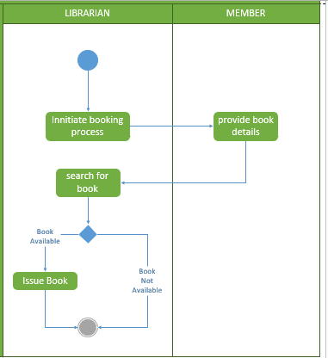
Activity diagram (issue book)
Issue Book:
Librarian initiates the process.
Member provides details and librarian verifies availability.
If available, book is borrowed and due date is set.
Process ends.

Slide 8
Activity diagram (return book)
Return Book:
Librarian initiates the process.
Member returns book and due date is checked.
If overdue, calculate the fine.
Book is marked as returned, and member's records are updated.
Process ends.

Slide 9
Implementation approach
Object-Oriented Approach: Implemented key functionalities using an object-oriented design, encapsulating entities like Librarian, Member, Book, and Date.
Borrowing and Returning Books: Executed the borrowing and returning logic within the Book class, updating due dates and borrower details and managing book availability.
User Interaction: Designed user-friendly interactions through console input/output (std::cout and std::cin), enhancing the user experience.
Fine Calculation Logic: Incorporated a fine calculation mechanism within the calcFine method, considering overdue books and applying a predefined fine rate.
Data Management: Utilized vectors to efficiently manage and track borrowed books for each member, ensuring accurate record-keeping.
Exception Handling: Implemented robust error-handling mechanisms, addressing scenarios such as attempting to borrow an already borrowed book.
Automated Processes: Employed a Makefile for streamlined compilation and linking processes, enhancing project automation.

Slide 10
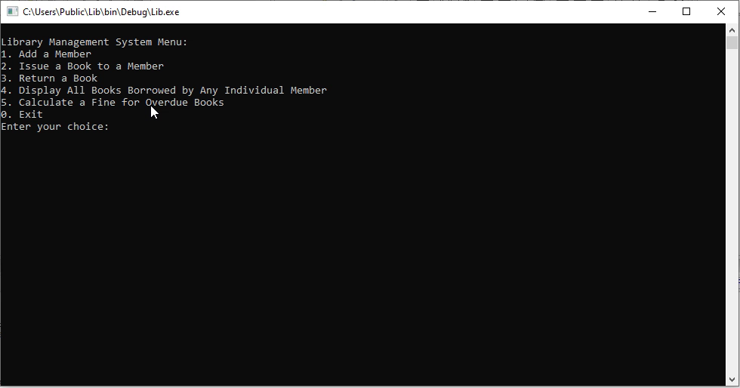
Implementation

Slide 11
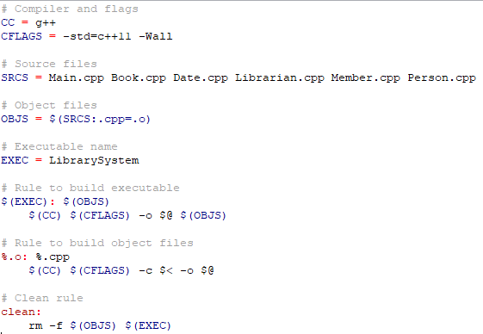
Make file use
ompiler and Flags:
CC = g++: Specifies the compiler as g++.
CFLAGS = -std=c++11 -Wall: Sets compiler flags, including C++11 standard and enabling warnings.
Source Files:
SRCS = Main.cpp Book.cpp Date.cpp Librarian.cpp Member.cpp Person.cpp: Lists all source files.
Object Files:
OBJS = $(SRCS:.cpp=.o): Generates a list of object files from source files.
Executable Name:
EXEC = LibrarySystem: Specifies the name of the executable.
Build Rule:
$(EXEC): $(OBJS): States that the executable depends on the object files.
Object Files Build Rule:
%.o: %.cpp: Specifies a generic rule for building object files from source files.
Build Command:
$(CC) $(CFLAGS) -o $@ $(OBJS): The command to build the executable from object files.
Clean Rule:
clean:: Indicates a rule named 'clean'.
Clean Command:
rm -f $(OBJS) $(EXEC): Removes object files and the executable when make clean is invoked.

Slide 12
Version control application
Change Tracking and History:
Tracked changes at the file level, providing a detailed history of modifications for better traceability.
Branching and Merging:
Utilized branching for parallel development and merging to integrate new features or bug fixes efficiently.
Code Review Support:
Facilitated effective code reviews by sharing changes easily and enabling collaborative discussions.
Error Reversion Capability:
Provided the ability to revert to previous, stable versions in case of errors or unforeseen issues.
Documentation through Commit Messages:
Maintained meaningful commit messages, documenting each change made during development.
Efficient Deployment Management:
Streamlined deployment processes by effectively managing different versions and releases using Git.

Slide 13
TesTIng approach:
Alwi Jamal
M00821180

Slide 14
STATEMENT OF APPROACH USED
Unit Testing: Ensured individual components (classes and functions) function as expected in isolation, validating their correctness.
Integration Testing: Verified the collaboration and interaction between modules to guarantee smooth integration and seamless functionality.
System Testing: Conducted end-to-end testing to evaluate the system’s behaviour and adherence to functional requirements.
Test Cases Development: Created diverse test cases covering typical and edge scenarios, focusing on critical functionalities.
Iterative Testing: Adopted an iterative testing process, revisiting and updating test cases based on code changes to maintain test relevance.
Automation Where Applicable: Automated repetitive and regression tests for efficiency, ensuring consistent validation during the development lifecycle.

Slide 15
Software demonstration
Member Addition:
Start with the process of adding a new member.
Input member details: ID, name, address, and email.
Book Issuance:
Input member ID and book ID for the issuance.
Highlight the interaction with the system, including due date input.
Demonstrate the successful issuance and system's confirmation.
Book Return:
Illustrate the book return process initiated by a member.
Emphasize the update of the member's borrowed books list.
Display Borrowed Books:
Display the functionality to view books borrowed by a specific member.
Input a member ID and showcase the accurate listing of borrowed books.
Demonstrate the system's ability to retrieve and present relevant information.
Fine Calculation:
Demonstrate the fine calculation for overdue books.
Input a member ID and show the calculation process.
Present fines associated with each overdue book, if applicable.

Slide 16
Conclusion
Accomplished the development and implementation of a robust library management system.
The system demonstrates effective integration of key functionalities, covering member management, book transactions, and fine calculations.
Software testing ensured the reliability and correctness of the software.
Software testing Git for Version Control:
Leveraged Git for efficient version control, ensuring a structured development process.
Created comprehensive documentation, including UML diagrams and detailed test cases.
The project enhanced understanding of the system's architecture and functionalities, facilitating future software maintenance.

